Slide 1



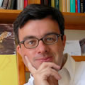


Low-dimensional Structures and Deep Models for High-dimensional (Visual) Data
Yi Ma
EECS Department, UC Berkeley
Dutch Mathematical Congress, April 4, 2018

Slide 2
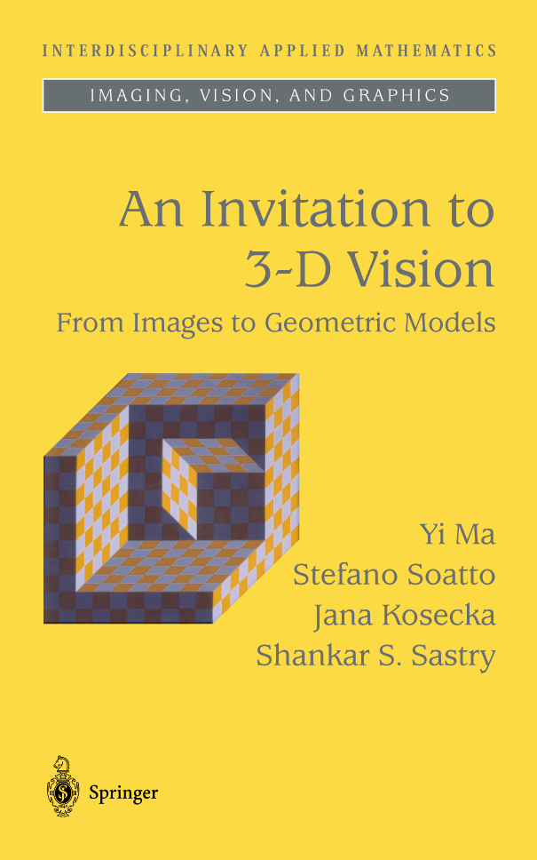

My Interests – From 3-D Vision to High-Dim Data
In order to recover 3D geometry from 2D images, we need
to understand low-dim structures in high-dim spaces…
2003
2016
soon
Notes:
Reason is clear
IF … reliably extract good representations
Classical applications in image and video processing
Futuristic applications: image understanding and web data analysis

Slide 3
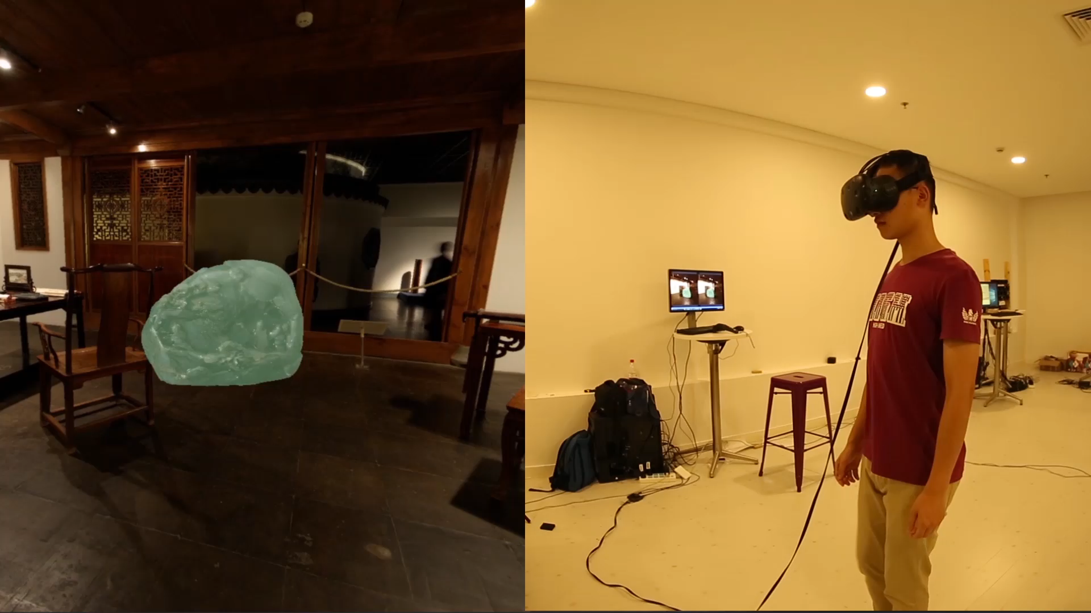
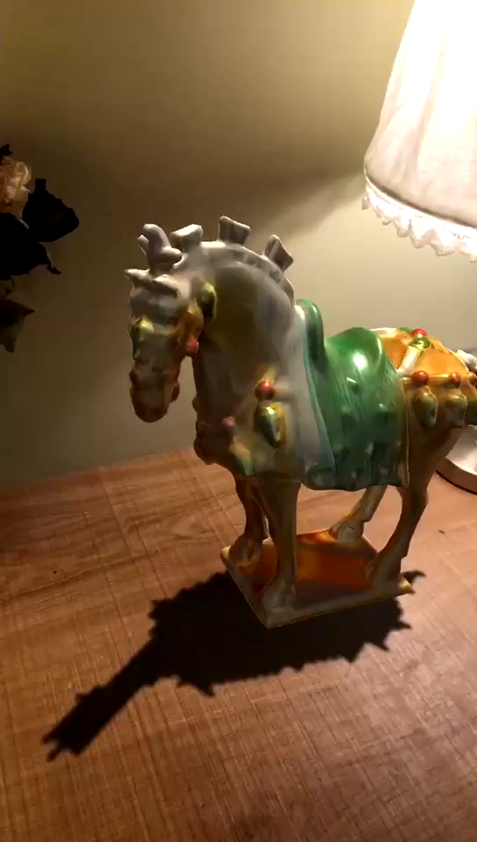
Capturing Shape and Texture of 3D Objects
Shanghai Museum Items
On HTC VIVE
On iPhone VR kit
With Jingyi Yu of ShanghaiTech, 2017

Slide 4



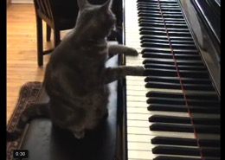



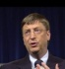

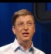
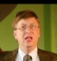
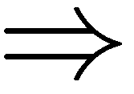
CONTEXT – Data increasingly massive, high-dimensional…
Images
??
1M pixels
Compression
De-noising
Super-resolution
Recognition…
Videos
1B voxels
User data
Streaming
Tracking
Stabilization…
1B users
Web data
Clustering
Classification
Collaborative filtering…
100B webpages
Indexing
Ranking
Search…
How to extract low-dim structures from such high-dim data?
Notes:
Reason is clear
IF … reliably extract good representations
Classical applications in image and video processing
Futuristic applications: image understanding and web data analysis

Slide 5
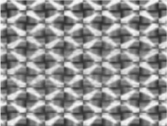
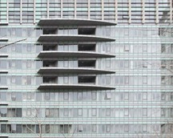
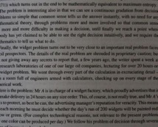
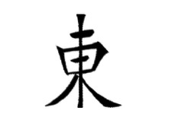
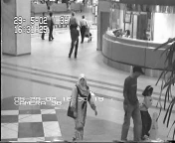
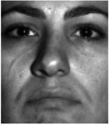
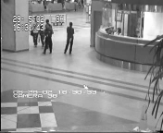
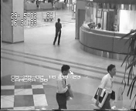
CONTEXT – Low dimensional structures in visual data
Visual data exhibit low-dimensional structures due to rich local regularities, global symmetries, repetitive patterns, or redundant sampling.
Notes:
Today I will focus on one particular observation in automatic face recognition.

Slide 6

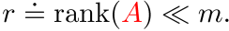

CONTEXT – PCA: Fitting Data with a Low-dim. Subspace
If we view the data (image) as a matrix
then
Principal Component Analysis (PCA) via singular value decomposition (SVD):
Optimal estimate of under iid Gaussian noise
Efficient and scalable computation
Fundamental statistical tool, with huge impact in image processing,
vision, web search, bioinformatics…
But… PCA breaks down under even a single corrupted observation.
Notes:
Today I will focus on one particular observation in automatic face recognition.

Slide 7
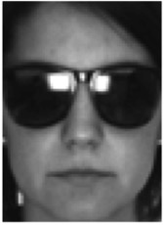
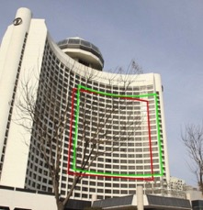












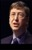
















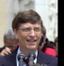





CONTEXT – But life is not so easy…
Real application data often contain missing observations, corruptions, or subject to unknown deformation or misalignment.
Classical methods (e.g., PCA, least square regression) break down…

Slide 8
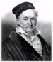


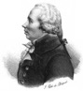
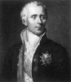
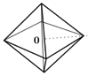
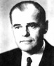
Everything old …
A long and rich history of robust estimation with error correction and missing data imputation:
R. J. Boscovich. De calculo probailitatum que respondent diversis valoribus summe errorum post plures observationes … , before 1756
A. Legendre. Nouvelles methodes pour la determination des orbites des cometes, 1806
over-determined
+ dense, Gaussian
C. Gauss. Theory of motion of heavenly bodies, 1809
A. Beurling. Sur les integrales de Fourier absolument convergentes et leur application a une transformation functionelle, 1938
B. Logan. Properties of High-Pass Signals, 1965
underdetermined
+ sparse, Laplacian

Slide 9

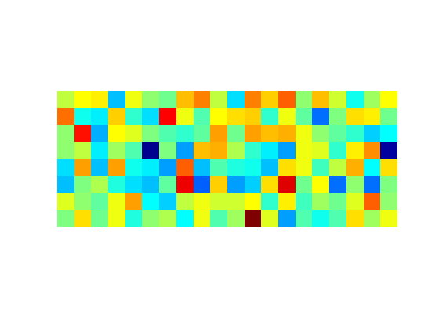
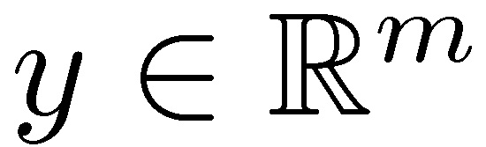

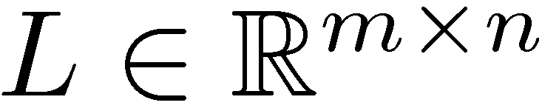

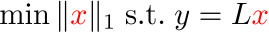

CONTEXT – Recent related progress
Sparse recovery:
Impossible in general ( )
Well-posed if is structured (sparse), but still NP-hard
Tractable via convex optimization:
… if is “nice” (random, incoherent, RIP)
Hugely active area: Donoho+Huo ’01, Elad+Bruckstein’03, Candès+Tao’04,’05, Tropp ’04,06, Donoho’04, Fuchs’05, Zhao+Yu’06, Meinshausen+Buhlmann’06, Wainwright’09, Donoho+Tanner’09, Dimakis+Xu+Hassibi’09, … and many others
A
Notes:
Today I will focus on one particular observation in automatic face recognition.

Slide 10

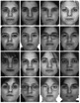
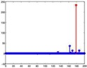





CONTEXT – Recent related progress
Robust recovery:
Impossible in general ( )
Well-posed if is sparse, errors not too dense, but still NP-hard
Tractable: via convex optimization:
… if is “nice” (cross and bouquet)
Hugely active area: Candès+Tao’05, Wright+Ma’10, Nguyen+Tran’11, Li ’11, also Zhang, Yang, Huang’11, Oymak+Tropp’15 etc…
Notes:
Today I will focus on one particular observation in automatic face recognition.

Slide 11

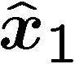

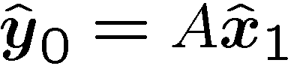
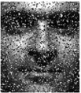
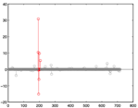
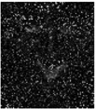
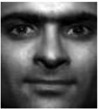
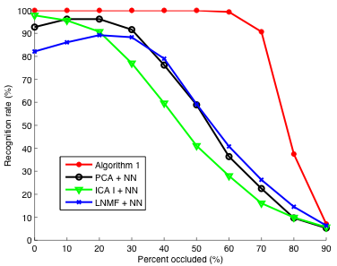
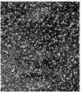
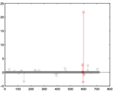
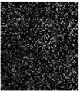
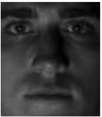
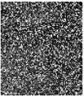
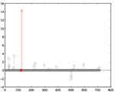
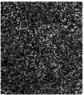
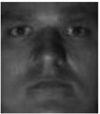
EXPERIMENTS – Varying Level of Random Corruption
Extended Yale B Database
(38 subjects)
Training: subsets 1 and 2 (717 images)
Testing: subset 3 (453 images)
99.3%
90.7%
30% corruption
50%
37.5%
70%
Wright, Yang, Ganesh, Sastry, and Ma. Robust Face Recognition via Sparse Representation, TPAMI 2009
Notes:
Today I will focus on one particular observation in automatic face recognition.

Slide 12
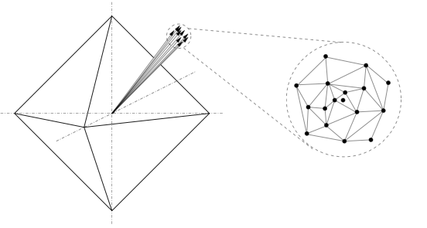

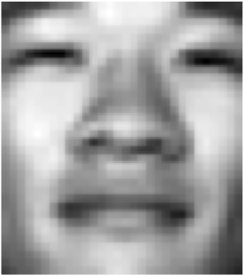







Theory – Geometry and Statistics of Face Images
Highly coherent
( volume )
“ recovers any sparse signal from almost any error with density less than 1”
Dense Error Correction via L1 –minimization, IEEE Trans. Information Theory, 2010

Slide 13

CONTEXT – Basic Algorithm for Sparsity (ISTA)
Soft Thresholding
Nonlinear Thresholding ReLu(w)
ReLu
Deep
Neural
Network
Module
0
wij
Linear Operator w=Ax
Notes:
Today I will focus on one particular observation in automatic face recognition.

Slide 14
CONTEXT – Learned ISTA (LISTA)
If only interested in one instance: AND with many training data: {(y_{i}, x_{i})}.
We can optimize the optimization path of ISTA using supervised learning:
Gregor and LeCun, in ICML 2010.
Notes:
Today I will focus on one particular observation in automatic face recognition.

Slide 15









CONTEXT – Recent related progress
Low-rank recovery:
Impossible in general ( )
Well-posed if is structured (low-rank), but still NP-hard
Tractable via convex optimization:
… if is “nice” (random, rank-RIP)
Hugely active area: Recht+Fazel+Parillo’07, Candès+Plan’10, Mohan+Fazel’10, Recht+Xu+Hassibi’11, Chandrasekaran+Recht+Parillo+Willsky’11, Negahban+Wainwright’11, Oymak+Tropp’15 …
,
Notes:
Today I will focus on one particular observation in automatic face recognition.

Slide 16





CONTEXT – Recent related progress
Matrix completion:
Impossible in general ( )
Well-posed if is structured (low-rank), but still NP-hard
Tractable via convex optimization:
… if is “nice” (random subset) ...
… and interacts “nicely” with ( incoherent – not “spiky”).
Hugely active area: Candès+Recht ‘08, Keshevan+Oh+Montonari ‘09, Candès+Tao ‘09, Gross ‘10, Recht ‘10, Negahban+Wainwright ’10, Oymak+Tropp’15…
??
Notes:
Today I will focus on one particular observation in automatic face recognition.

Slide 17






CONTEXT – Why Should You Care?
Learning Graphical Models
cond. indep. given other variables
Separation Principle:
sparse pattern → conditional (in)dependence
rank of second component → number of hidden variables
Chandrasekharan, Parrilo, and Wilsky of MIT, Annual of Statistics, 2012
Notes:
Today I will focus on one particular observation in automatic face recognition.

Slide 18
CONTEXT – Why Should You Care?
Learning Deep Neural Networks
From information-theoretic perspective, DNNs (with softmax objective) is to learn a low-rank approximation of the joint distribution P(X,Y) of the input X and output Y.
Lizhong Zheng of MIT, Submitted to ICML 2018
Notes:
Today I will focus on one particular observation in automatic face recognition.

Slide 19


CONTEXT – Low-dimensional Models
The data should be low-dimensional (low-rank):
… but some of the observations are grossly corrupted:
… and all of the observations are noisy:
… and many of them are missing:
Notes:
Today I will focus on one particular observation in automatic face recognition.

Slide 20


CONTEXT – Low-dimensional Models
The data should be low-dimensional:
… but some of the observations are grossly corrupted:
… and all of the observations are noisy:
… and many of them are missing:
Notes:
Today I will focus on one particular observation in automatic face recognition.

Slide 21



CONTEXT – Low-dimensional Models
The data should be low-dimensional:
… but some of the observations are grossly corrupted:
… and some of them can be missing too:
Notes:
Today I will focus on one particular observation in automatic face recognition.

Slide 22

CONTEXT – Low-dimensional Models
The data should be low-dimensional:
… but some of the observations are grossly corrupted:
… and some of them can be missing too:
… special cases of a more general problem:
Notes:
Today I will focus on one particular observation in automatic face recognition.

Slide 23



THIS TALK
h
Given observations with
low-rank,
sparse,
small, dense noise,
recover a good estimate of and .
Theory and Algorithm
Provably Correct and Tractable Solution
Provably Optimal and Efficient Algorithms
Potential Applications
Visual Data (Restoration, Reconstruction, Recognition)
Other Data
Extensions and Conclusions
Notes:
Today I will focus on one particular observation in automatic face recognition.

Slide 24







ROBUST PCA – Problem Formulation
- observation
– low-rank
– sparse
Problem: Given recover and .
Low-rank component
Sparse component (gross errors)
Numerous approaches in the literature:
Multivariate trimming [Gnanadesikan and Kettering ‘72]
Power Factorization [Wieber’70s]
Random sampling [Fischler and Bolles ‘81]
Alternating minimization [Shum & Ikeuchi’96, Ke and Kanade ‘03]
Influence functions [de la Torre and Black ‘03]
Key question: can guarantee correctness with an efficient algorithm?
Notes:
Today I will focus on one particular observation in automatic face recognition.

Slide 25



ROBUST PCA – Convex Surrogates for Sparsity and Rank
Seek the lowest-rank that agrees with the data up to some sparse error :
But INTRACTABLE! Relax with convex surrogates:
L₁ norm
Nuclear norm
Convex envelope over
Notes:
Today I will focus on one particular observation in automatic face recognition.

Slide 26
ROBUST PCA – By Convex Optimization
Seek the lowest-rank that agrees with the data up to some sparse error :
But INTRACTABLE! Relax with convex surrogates:
L₁ norm
Nuclear norm
Semidefinite program, solvable in polynomial time
V. Chandrasekaran et. al. IFAC 2009, J. Wright et. al. NIPS 2009.
Notes:
Today I will focus on one particular observation in automatic face recognition.

Slide 27




ROBUST PCA – When the Convex Program Works?
White regions are instances with perfect recovery.
Correct recovery when is indeed low-rank and is indeed sparse?
Notes:
Today I will focus on one particular observation in automatic face recognition.

Slide 28



MAIN THEORY – Exact Solution by Convex Optimization
Non-adaptive weight factor
GREAT NEWS: “Convex optimization recovers almost any matrix of rank from errors corrupting of the observations!”
Candes, Li, Ma, and Wright, Journal of the ACM, May 2011.
Notes:
Today I will focus on one particular observation in automatic face recognition.

Slide 29



MAIN THEORY – Corrupted, Incomplete Matrix
Candes, Li, Ma, and Wright, Journal of the ACM, May 2011.
Notes:
Today I will focus on one particular observation in automatic face recognition.

Slide 30


MAIN THEORY – With Dense Errors and Noise
Ganesh, Zhou, Li, Wright , Ma, Candes, ISIT, 2010.
Notes:
Today I will focus on one particular observation in automatic face recognition.

Slide 31



BIG PICTURE – Landscape of Theoretical Guarantees
Many have made contributions in the past few years:
Matrix Recovery (RPCA)
Matrix Completion
D. Gross
E. Candes (Stanford)
B. Recht (UC Berkeley)
J. Wright (Columbia)on Information Forensics & Security
J. Tropp (Caltech)
V. Chandrasekharan (Caltech)
B. Hassibi (Caltech)
P. Parrilo (MIT)
Willsky (MIT)
Hastie (Stanford)
Montanari (Stanford)
M. Jordan (Berkeley)
M. Wainwright (Berkeley)
B. Yu (Berkeley)
Singer (Princeton)
T. Tao (UCLA)
S. Osher (UCLA)
O. Milenkovic (UIUC)
Y. Bresler (UIUC)
Y. Ma (UIUC)
M. Fazel (U Wash.)
… …
1
random signs
1
rank =
rank =
0
0
1
0
0
1
Classical PCA
Universality of phase transition (Oymak & Tropp). But does not yet apply here…
Notes:
Today I will focus on one particular observation in automatic face recognition.

Slide 32

ALGORITHMS – Are scalable solutions possible?
Seemingly BAD NEWS: Our optimization problem
is high-dimensional and non-smooth.
Convergence rate of solving a generic convex program:
Second-order Newton method, linear rate of convergence , but not scalable!
First-order methods depend strongly on the smoothness of f :
Y. Nesterov, Introductory Lectures on Convex Optimization: A Basic Course, 2003.
Notes:
Here I give an sample to show to how impractical those algorithms by theoreticians are.
This algorithm is inspired by Candès et al.’s work on matrix completion, a closely related problem.

Slide 33


ALGORITHMS – Why are scalable solutions possible?
GOOD NEWS: The objective function has special structures
KEY OBSERVATION: Simple solutions for the proximal operations, given by soft-thresholding the entries or singular values of the matrix, respectively.
Notes:
Here I give an sample to show to how impractical those algorithms by theoreticians are.
This algorithm is inspired by Candès et al.’s work on matrix completion, a closely related problem.

Slide 34
ALGORITHMS – Evolution of scalable algorithms
GOOD NEWS: Scalable first-order gradient-descent algorithms:
Proximal Gradient [Osher, Mao, Dong, Yin ’09,Wright et. al.’09, Cai et. al.’09].
Accelerated Proximal Gradient [Nesterov ’83, Beck and Teboulle ‘09]:
Augmented Lagrange Multiplier [Hestenes ‘69, Powell ’69]:
Alternating Direction Method of Multipliers [Gabay and Mercier ‘76].
For a 1000x1000 matrix of rank 50, with 10% (100,000) entries randomly corrupted:
Algorithms | Accuracy | Rank | ||E||_0 | # iterations | time (sec)
IT | 5.99e-006 | 50 | 101,268 | 8,550 | 119,370.3
DUAL | 8.65e-006 | 50 | 100,024 | 822 | 1,855.4
APG | 5.85e-006 | 50 | 100,347 | 134 | 1,468.9
APG_{P} | 5.91e-006 | 50 | 100,347 | 134 | 82.7
EALM_{P} | 2.07e-007 | 50 | 100,014 | 34 | 37.5
IALM_{P} | 3.83e-007 | 50 | 99,996 | 23 | 11.8
10,000
times
speedup!
Lin, Chen, and Ma, UILU-ENG-09-2214, 2010.
Notes:
Today I will focus on one particular observation in automatic face recognition.

Slide 35


ALGORITHMS – Evolution of scalable algorithms
A scalable algorithm: alternating direction method (ADMoM) for ALM:
Shrink singular values
repeat
Shrink absolute values
Y_{k}
Linear operator
Residual Network Module
Lagrange
Multiplier
Update
Nonlinear thresholding
Linear operator
Y_{k+1}
Lin, Chen, and Ma, UILU-ENG-09-2214, 2010.
Notes:
Today I will focus on one particular observation in automatic face recognition.

Slide 36
ALGORITHMS – Evolution of fast algorithms (around 2009)
For a 1000x1000 matrix of rank 50, with 10% (100,000) entries randomly corrupted:
Algorithms | Accuracy | Rank | ||E||_0 | # iterations | time (sec)
IT | 5.99e-006 | 50 | 101,268 | 8,550 | 119,370.3
DUAL | 8.65e-006 | 50 | 100,024 | 822 | 1,855.4
APG | 5.85e-006 | 50 | 100,347 | 134 | 1,468.9
APG_{P} | 5.91e-006 | 50 | 100,347 | 134 | 82.7
EALM_{P} | 2.07e-007 | 50 | 100,014 | 34 | 37.5
IALM_{P} | 3.83e-007 | 50 | 99,996 | 23 | 11.8
10,000
times
speedup!
Provably Robust PCA at only a constant factor (≈20) more computation than conventional PCA!
Notes:
Now I compare the algorithms we have found in the past year. These algorithms are listed in a chronological order.
Highlight:
The algorithms are listed in a chronological order;
The number of iterations is constant;
Can run moderately sized data, e.g. 5kx5k, on a single PC.
Now we are able to compute 50kx50k matrices on a cluster.

Slide 37

ALGORITHMS – Convergence rate with strong convexity
GREAT NEWS: Geometric convergence for gradient algorithms!
[Agarwal, Negahban, Wainwright, NIPS 2010]

Slide 38

ALGORITHMS – Recap and Conclusions

Slide 39
APPLICATIONS
Repairing Images and Videos
Image Repairing, Background Extraction, Street Panorama
Reconstructing 3D Geometry
Shape from Texture, Featureless 3D Reconstruction
Registering Multiple Images
Multiple Image Alignment, Video Stabilization
Recognizing Objects
Faces, Texts, etc.
Other Data and Applications
Notes:
Today I will focus on one particular observation in automatic face recognition.

Slide 40
Implications – Highly Compressive Sensing of Structured Information!
Recover low-dimensional structures from a fraction of missing
measurements with structured support.
compressive samples
Low-rank Structures
Sparse Structures

Slide 41


Repairing Images – Highly Robust Repairing of Low-rank Textures!
Low-rank Texture
Corruptions
Liang, Ren, Zhang, and Ma, in ECCV 2012.

Slide 42
Repairing Low-rank Textures
Low-rank Method
Photoshop
Input
Output
Liang, Ren, Zhang, and Ma, in ECCV 2012.

Slide 43
Repairing (Distorted) Low-rank Textures
Low-rank Method
Photoshop
Input
Output
Liang, Ren, Zhang, and Ma, in ECCV 2012.

Slide 44
Structured Texture Completion and Repairing
Liang, Ren, Zhang, and Ma, in ECCV 2012.

Slide 45











Repairing Multiple Correlated Images
58 images of one person under varying lighting:
…
specularity
RPCA
…
cast
shadows
Candes, Li, Ma, and Wright, Journal of the ACM, May 2011.
Notes:
Today I will focus on one particular observation in automatic face recognition.

Slide 46



Repairing Images – robust photometric stereo
Input images
Mean error 0.014º 0.96º
Max error 0.20º 8.0º
Wu, Ganesh, Li, Matsushita, and Ma, in ACCV 2010.
Notes:
Today I will focus on one particular observation in automatic face recognition.

Slide 47








Repairing Video Frames – background modeling from video
Surveillance video
200 frames,
144 x 172 pixels,
Significant foreground
motion
Video =
Low-rank appx. +
Sparse error
…
RPCA
…
Candès, Li, Ma, and Wright, JACM, May 2011.
Notes:
Today I will focus on one particular observation in automatic face recognition.

Slide 48
Implications – Highly Compressive Sensing of Structured Information!
Recover low-dimensional structures from diminishing fraction of
corrupted measurements.
compressive samples
Low-rank Structures
Sparse Structures

Slide 49







Repairing Video Frames – Street Panorama

Slide 50



Repairing Video Frames – Street Panorama
Low-rank
AutoStitch
Photoshop

Slide 51



Repairing Video Frames – Street Panorama
Low-rank
AutoStitch
Photoshop

Slide 52




Sensing or Imaging of Low-rank and Sparse Structures
Fundamental Problem: How to recover low-rank and sparse structures from
corrupted data
Low-rank Structures
Sparse Structures
subject to either nonlinear deformation or linear compressive sampling ?

Slide 53




Reconstructing 3D Geometry and Structures
– deformed observation
– low-rank structures
– sparse errors
o
Problem: Given recover , and simultaneously.
Low-rank component
(regular patterns…)
Sparse component
(occlusion, corruption, foreground…)
Parametric deformations
(affine, projective, radial distortion, 3D shape…)
Notes:
Today I will focus on one particular observation in automatic face recognition. (mov=>GIF)

Slide 54
Transform Invariant Low-rank Textures (TILT)
– deformed observation
– low-rank structures
– sparse errors
o
Objective: Transformed Principal Component Pursuit::
Solution: Iteratively solving the linearized convex program::
Or reduced version:
Zhang, Liang, Ganesh, Ma, ACCV’10, IJCV’12
Notes:
Today I will focus on one particular observation in automatic face recognition.

Slide 55

THEORY – Compressive Robust PCA
A nearly optimal lower bound on minimum # of measurements!
Wright, Ganesh, Min, and Ma, IMA Information & Inference 2015, the Best Paper 2nd Prize

Slide 56






TILT – Shape from texture
Input (red window )
Output (rectified green window )
Zhang, Liang, Ganesh, Ma, ACCV’10, IJCV’12

Slide 57








TILT – Shape and geometry from textures
Zhang, Liang, and Ma, in ICCV 2011
Notes:
Adding virtual object to the image based on correct perspective and 3D geometry.

Slide 58




TILT – Virtual reality
Zhang, Liang, and Ma, in ICCV 2011
Notes:
Adding virtual object to the image based on correct perspective and 3D geometry.

Slide 59






TILT – Camera Calibration with Radial Distortion
Zhang, Matsushita, and Ma, in CVPR 2011
Notes:
Adding virtual object to the image based on correct perspective and 3D geometry.

Slide 60

TILT – Camera Calibration with Radial Distortion
Previous approach
Low-rank method
Zhang, Matsushita, and Ma, in CVPR 2011
Notes:
Adding virtual object to the image based on correct perspective and 3D geometry.

Slide 61




TILT – Holistic 3D Reconstruction of Urban Scenes
Mobahi, Zhou, and Ma, in ICCV 2011
Notes:
Adding virtual object to the image based on correct perspective and 3D geometry.

Slide 62





TILT – Holistic 3D Reconstruction of Urban Scenes
From one input image
From four input images
Mobahi, Zhou, and Ma, in ICCV 2011
Notes:
Adding virtual object to the image based on correct perspective and 3D geometry.

Slide 63





TILT – Holistic 3D Reconstruction of Urban Scenes
From eight input images
Mobahi, Zhou, and Ma, in ICCV 2011
Notes:
Adding virtual object to the image based on correct perspective and 3D geometry.

Slide 64

Virtual reality in urban scenes

Slide 65





Registering Multiple Images – Robust Alignment
– corrupted & misaligned
observation
– aligned low-rank
signals
– sparse errors
…
o
…
…
Problem: Given recover , and .
Parametric deformations
(rigid, affine, projective…)
Low-rank component
Sparse component
Solution: Robust Alignment via Low-rank and Sparse (RASL) Decomposition
Iteratively solving the linearized convex program::
Notes:
Today I will focus on one particular observation in automatic face recognition.

Slide 66












































RASL – Aligning Face Images from the Internet
Peng, Ganesh, Wright, Ma, CVPR’10, TPAMI’11
*48 images collected from internet
Notes:
Here is an example to align Bill Gates’ faces. 48 images are collected from internet

Slide 67
RASL – Faces Detected
Input: faces detected by a face detector ( )
Average
Peng, Ganesh, Wright, Ma, CVPR’10, TPAMI’11

Slide 68

RASL – Faces Aligned
Output: aligned faces ( )
Average
Peng, Ganesh, Wright, Ma, CVPR’10, TPAMI’11

Slide 69
RASL – Faces Repaired and Cleaned
Output: clean low-rank faces ( )
Average
Peng, Ganesh, Wright, Ma, CVPR’10, TPAMI’11

Slide 70
RASL – Sparse Errors of the Face Images
Output: sparse error images ( )
Peng, Ganesh, Wright, Ma, CVPR’10, TPAMI’11

Slide 71






Object Recognition – Regularity of Texts at All Scales!
Input (red window )
Output (rectified green window )
Zhang, Liang, Ganesh, Ma, ACCV’10 and IJCV’12

Slide 72









Recognition – Street Sign Rectification
Xin Zhang, Zhouchen Lin, and Ma, ICDAR 2013
Notes:
Adding virtual object to the image based on correct perspective and 3D geometry.

Slide 73
Recognition – Character Rectification and Recognition
Microsoft OCR for rotated characters
(2,500 common Chinese characters)
Microsoft OCR for skewed characters (2,500 common Chinese characters)
Xin Zhang, Zhouchen Lin, and Ma, ICDAR 2013
Notes:
Adding virtual object to the image based on correct perspective and 3D geometry.

Slide 74

Super Resolution via Transform Invariant Group Sparsity
稀疏表示字典 D
高清原图 x
稀疏表示： x = D a
a – 稀疏系数
H 下采样（4倍）
字典学习
超分辨率算法
高清训练图像集
低分辨率图 y ＝ H x
恢复的高清图像 x’

Slide 75



Super Resolution via Transform Invariant Group Sparsity
Aim: Exploiting non-local structures to perform super-resolution at large upsampling factors by
1. Learning the transformation that reveals the group-sparse structure of the image gradient (via TILT)
2. Enforcing this structure through group-sparse regularizers (DTV) that incorporates the transform and is consequently invariant to the transform
x 8
Carlos Fernandez and Emmanuel Candes of Stanford, ICCV2013

Slide 76

Super Resolution via Transform Invariant Group Sparsity
Carlos Fernandez and Emmanuel Candes of Stanford, ICCV2013

Slide 77
Take-home Messages for Visual Data Processing
(Transformed) low-rank and sparse structures are central to visual data modeling, processing, and analyzing;
Such structures can now be extracted correctly, robustly, and efficiently, from raw image pixels (or high-dim features);
These new algorithms unleash tremendous local or global information from single or multiple images, emulating or surpassing human capability;
4. These algorithms start to exert significant impact on image/video processing, 3D reconstruction, and object recognition.
… …
But try not to abuse or misuse them…
Notes:
Today I will focus on one particular observation in automatic face recognition.

Slide 78



Other Applications – Upright orientation of man-made objects
TILT for 3D: Unsupervised upright orientation of man-made 3D objects
Jin, Wu, and Liu of USTC, China, Graphical Models, 2012.
Notes:
Today I will focus on one particular observation in automatic face recognition.

Slide 79

Other Data/Applications – Web Image/Tag Refinement
Zhu, Yan of NUS, Singapore, ACM MM 2010.
Notes:
Today I will focus on one particular observation in automatic face recognition.

Slide 80



Other Data/Applications – Web Document Corpus Analysis
Latent Semantic Indexing: the classical solution (PCA)
Documents
Dense, difficult to interpret
Words
a better model/solution?
word frequency (or TF/IDF)
Low-rank
“background”
topic model
Informative,
discriminative
“keywords”
Notes:
Today I will focus on one particular observation in automatic face recognition.

Slide 81
Other Data/Applications – Sparse Keywords Extracted
Reuters-21578 dataset: 1,000 longest documents; 3,000 most frequent words
Min, Zhang, Wright, Ma, CIKM 2010.
Notes:
Today I will focus on one particular observation in automatic face recognition.

Slide 82


Other Data/Applications – Protein-Gene Correlation
Microarray data
Wang, Machiraju, and Huang of Ohio State Univ. , Bioinformatics.
Notes:
Today I will focus on one particular observation in automatic face recognition.

Slide 83


Other Data – Time Series Gene Expressions
Chang, Korkola, Amin, Tomlin of Berkeley, BiorXiv, 2014.
Notes:
Today I will focus on one particular observation in automatic face recognition.

Slide 84




Other Data/Applications – Lyrics and Music Separation
Songs (STFT)
Low-rank (music)
Sparse (voices)
Po-Sen Huang, Scott Chen, Paris Smaragdis, Mark Hasegawa-Johnson of UIUC, ICASSP 2012.
Notes:
Today I will focus on one particular observation in automatic face recognition.

Slide 85

Other Data/Applications – Internet Traffic Anomalies
Network Traffic = Normal Traffic + Sparse Anomalies + Noise
Mardani, Mateos, and Giannadis of Minnesota, Trans. Information Theory, 2013.
Notes:
Today I will focus on one particular observation in automatic face recognition.

Slide 86

Other Data/Applications – Robust Filtering and System ID
GPS on a Car:
gross sparse errors
(due to buildings, trees…)
Robust Kalman Filter:
Robust System ID:
Hankel matrix
Dynamical System Identification, Maryan Fazel, Stephen Boyd, 2000
Notes:
Today I will focus on one particular observation in automatic face recognition.

Slide 87








CONCLUSIONS – A Unified Theory for Sparsity and Low-Rank
Sparse Vector
individual signal
L₀ norm
L₁ norm
Low-Rank Matrix
correlated signals
Nuclear norm
Low-dimensionality of
Measure
Convex Surrogate
Compressed Sensing
Error Correction
Domain Transform
Mixed Structures
Joint NSF Project with Candes and Wright, 2010 - 2015
Notes:
Today I will focus on one particular observation in automatic face recognition.

Slide 88










Compressive Sensing of Low-Dimensional Structures

Slide 89

Compressive Sensing and Unmixing of Low-dim Structures
A nearly optimal lower bound on minimum # of measurements!
Wright, Ganesh, Min, and Ma, ISIT’12, IMA I&I Best Paper 2nd Prize

Slide 90
Extensions – A Suite of Powerful Regularizers
For compressive robust recovery of a family of low-dimensional structures:
[Zhou et. al. ‘09] Spatially contiguous sparse errors via MRF
[Bach ’10] – relaxations from submodular functions
[Negahban+Yu+Wainwright ’10] – geometric analysis of recovery
[Becker+Candès+Grant ’10] – algorithmic templates
[Xu+Caramanis+Sanghavi ‘11] column sparse errors L_{2,1} norm
[Recht+Parillo+Chandrasekaran+Wilsky ’11’12] – compressive sensing of various structures
[Candes+Recht ’11] – compressive sensing of decomposable structures
[McCoy+Tropp’11,Amenlunxen+McCoy+Tropp’13] – phase transition for recovery and decomposition of structures
[Wright+Ganesh+Min+Ma, ISIT’12,I&I’13] – compressive superposition of decomposable structures
Take home message: Let the data and application tell you the structure…
Notes:
Today I will focus on one particular observation in automatic face recognition.

Slide 91
Relationships with Deep Neural Networks
Evolution of the Structures of Deep Networks
FNN -> CNN -> ResNet -> ???
Deep Learning and Sparsity
Cascaded Structured Matrix Factorization
Global Optimality of Training
Supervision versus No-supervision
Simple Shallow Networks by Design
PCANet (and ScatteringNet and CapsuleNet)
Notes:
Today I will focus on one particular observation in automatic face recognition.

Slide 92


Evolution of DNN – More Principled Structures
Fully Connected
Neural Networks
(before 2011)
Convolution
Neural Networks
(AlexNet 2011)
translational invariance
Residual
Neural Networks
(2015, and AlphaGo Zero)
constrained optimization?
Notes:
Today I will focus on one particular observation in automatic face recognition.

Slide 93
Evolution of DNN – Temporal Sparse Coding & Stacked RNN
Temporally coherent Sparse Coding for Anomaly Detection in Video
RNN structures derived from group sparsity!
Luo, Liu and Gao of ShanghaiTech University, in ICCV 2017.
Notes:
Today I will focus on one particular observation in automatic face recognition.

Slide 94
Evolution of DNN – Graphical Model Inference as Networks
Structured Attentions for Visual Question Answering
Recurrent inference layers derived from MF or LBP (for graphical models)!
Zhu, Tu, and Ma et. al. of ShanghaiTech University, in ICCV 2017.
Notes:
Today I will focus on one particular observation in automatic face recognition.

Slide 95

II. Deep Learning and Sparsity
Deep learning is a cascaded matrix factorization
nonlinearity
features
weights
loss
labels
regularizer
Vidal, Haeffele, and Young of JHU, ICML2014

Slide 96

Deep Learning and Sparsity
Theorem: If the functions and are sums of positively homogeneous functions, then any local minimizer such that for some i and all k gives a global minimizer
Examples of positively homogeneous compositions
Matrix multiplication: matrix factorization
CANDECOMP/PARAFAC decompositions: tensor factorization
Rectified linear units + max pooling: deep learning
Examples of positively homogeneous regularizers
Sums of products of norms (L1, L2, TV, etc.): structured factorizations
Vidal, Haeffele, and Young of JHU, ICML2014

Slide 97

III. Supervision or None? - PCANet
2-3 layers, fixed topology, simplest data-adaptive linear mapping, and simplest nonlinear processing and simplest pooling…
PCANet, Chan and Ma et. al. in IEEE Trans. On Image Processing, 2015

Slide 98

PCANet – Basic Structure
Cascaded PCA filters
Binary hashing
Block-wise histogram
ScatteringNet (S. Mallat et. al. 2013)
CapsuleNet (G. Hinton et. al. 2017)
Two to three layers!
By design, no supervision!
Pure feed-forward, no BP!
PCANet, Chan and Ma et. al. in IEEE Trans. On Image Processing 2015

Slide 99


PCANet – Test on NIST FERET
FERET contains images of 1,196 different individuals with up to 5 images of each individual.
The probe set is divided into four subsets
Fb with different expression changes;
Fc with different lighting conditions;
Dup-I taken within the period of three to four months;
Dup-II taken at least one and a half year apart.
Gallery
Fb
Fc
Gallery
Dup-I
Dup-II
PCANet, Chan and Ma et. al. in IEEE Trans. On Image Processing 2015

Slide 100

PCANet – Test on NIST FERET
The non-overlapping block size (for histogram) is 15x15.
The dimension of the PCANet features are reduced to 1000 by a whitening PCA (WPCA).
“Trn. CD” means trained with standard FERET CD dataset
The NN classifier with cosine distance is used.
PCANet, Chan and Ma et. al. in IEEE Trans. On Image Processing 2015

Slide 101


PCANet – Test on LFW
LFW contains 13,233 face images of 5,749 individuals, collected from the web.
We use LFW-a [aligned version].
“Unsupervised” setting.
View 1 dataset is used to learn the PCA filters and the projection matrix of the WPCA, and to decide a matching threshold.
the trained PCANet is applied to View 2 dataset, 10 subsets of pairs.
Mismatched pairs
Matched pairs
PCANet, Chan and Ma et. al. in IEEE Trans. On Image Processing 2015

Slide 102

PCANet – Test on LFW
PCANet parameters: the filter size k1 = k2 = 7, the number of filters L1 = L2 = 8, and block size is 15x13.
The features of PCANet-1 and PCANet-2 are projected onto 400 and 3,200 dimensions, respectively.
“sqrt” means PCA features followed with a square-root operation.
We use NN classifier with cosine distance.
PCANet, Chan and Ma et. al. in IEEE Trans. On Image Processing 2015

Slide 103
REFERENCES
From Supervised to Unsupervised Learning,
From One Subspace to Multiple Subspaces.
A recent book:
Generalized Principal Component Analysis
R. Vidal, Yi Ma, S. Sastry, Springer 2016

Slide 104
REFERENCES
Core References:
Robust Principal Component Analysis? Candes, Li, Ma, Wright, Journal of the ACM, 2011.
TILT: Transform Invariant Low-rank Textures, Zhang, Liang, Ganesh, and Ma, IJCV 2012.
Compressive Principal Component Pursuit, Wright, Ganesh, Min, and Ma, IMA I&I 2013.
Website (codes, applications, & references):
http://perception.csl.illinois.edu/matrix-rank/home.html
A New Graduate Textbook:
High-Dimensional Data Analysis with Sparse and Low-Dimensional Models
-- Theory, Algorithms, Applications

Slide 105





A Perfect Storm…
Mathematical Theory
(high-dimensional statistics, convex geometry,
measure concentration, combinatorics…)
Cloud Computing
(parallel, distributed, scalable platforms)
BIG DATA
(images, videos,
voices, texts,
biomedical, geospatial,
consumer data…)
Applications
& Services
(data processing,
analysis, compression,
knowledge discovery,
search, recognition…)
Computational Methods
(convex optimization, first-order algorithms,
random sampling, deep networks…)
Notes:
Today I will focus on one particular observation in automatic face recognition.

Slide 106
ACKNOWLEDGEMENT
Colleagues: Students:
Prof. Emmanuel Candes (Stanford)
Prof. Zhouchen Lin (MSRA, now Peking Univ.)
Prof. Yasuyuki Matsushita (MSRA, now Osaka Univ.)
Prof. Shuicheng Yan (Na. Univ. Singapore)
Prof. Lei Zhang (HK Polytech Univ.)
Prof. Liangshen Zhuang (USTC)
Prof. Weisheng Dong (Xidian Univ., China)
Prof. Shenghua Gao (ShanghaiTech Univ., China)
Prof. Rene Vidal (Johns Hopkins Univ.)
John Wright (UIUC, now Columbia)
Arvind Ganesh (UIUC, now Google)
Zhengdong Zhang (MSRA, now MIT)
Xiao Liang (MSRA, Tsinghua University)
Xin Zhang (MSRA, Tsinghua University)
Kerui Min (UIUC, now BosonNLP)
Zhihan Zhou (UIUC, now PennState)
Hossein Mobahi (UIUC, now Google)
Guangcan Liu (UIUC, now NUIST)
Xiaodong Li (Stanford, now UC Davis)
Carlos Fernandez (Stanford, now NYU)
Dutch Mathematical Congress, April 4, 2018

Slide 107





THANK YOU!
Questions, please?
o

